Slide 1
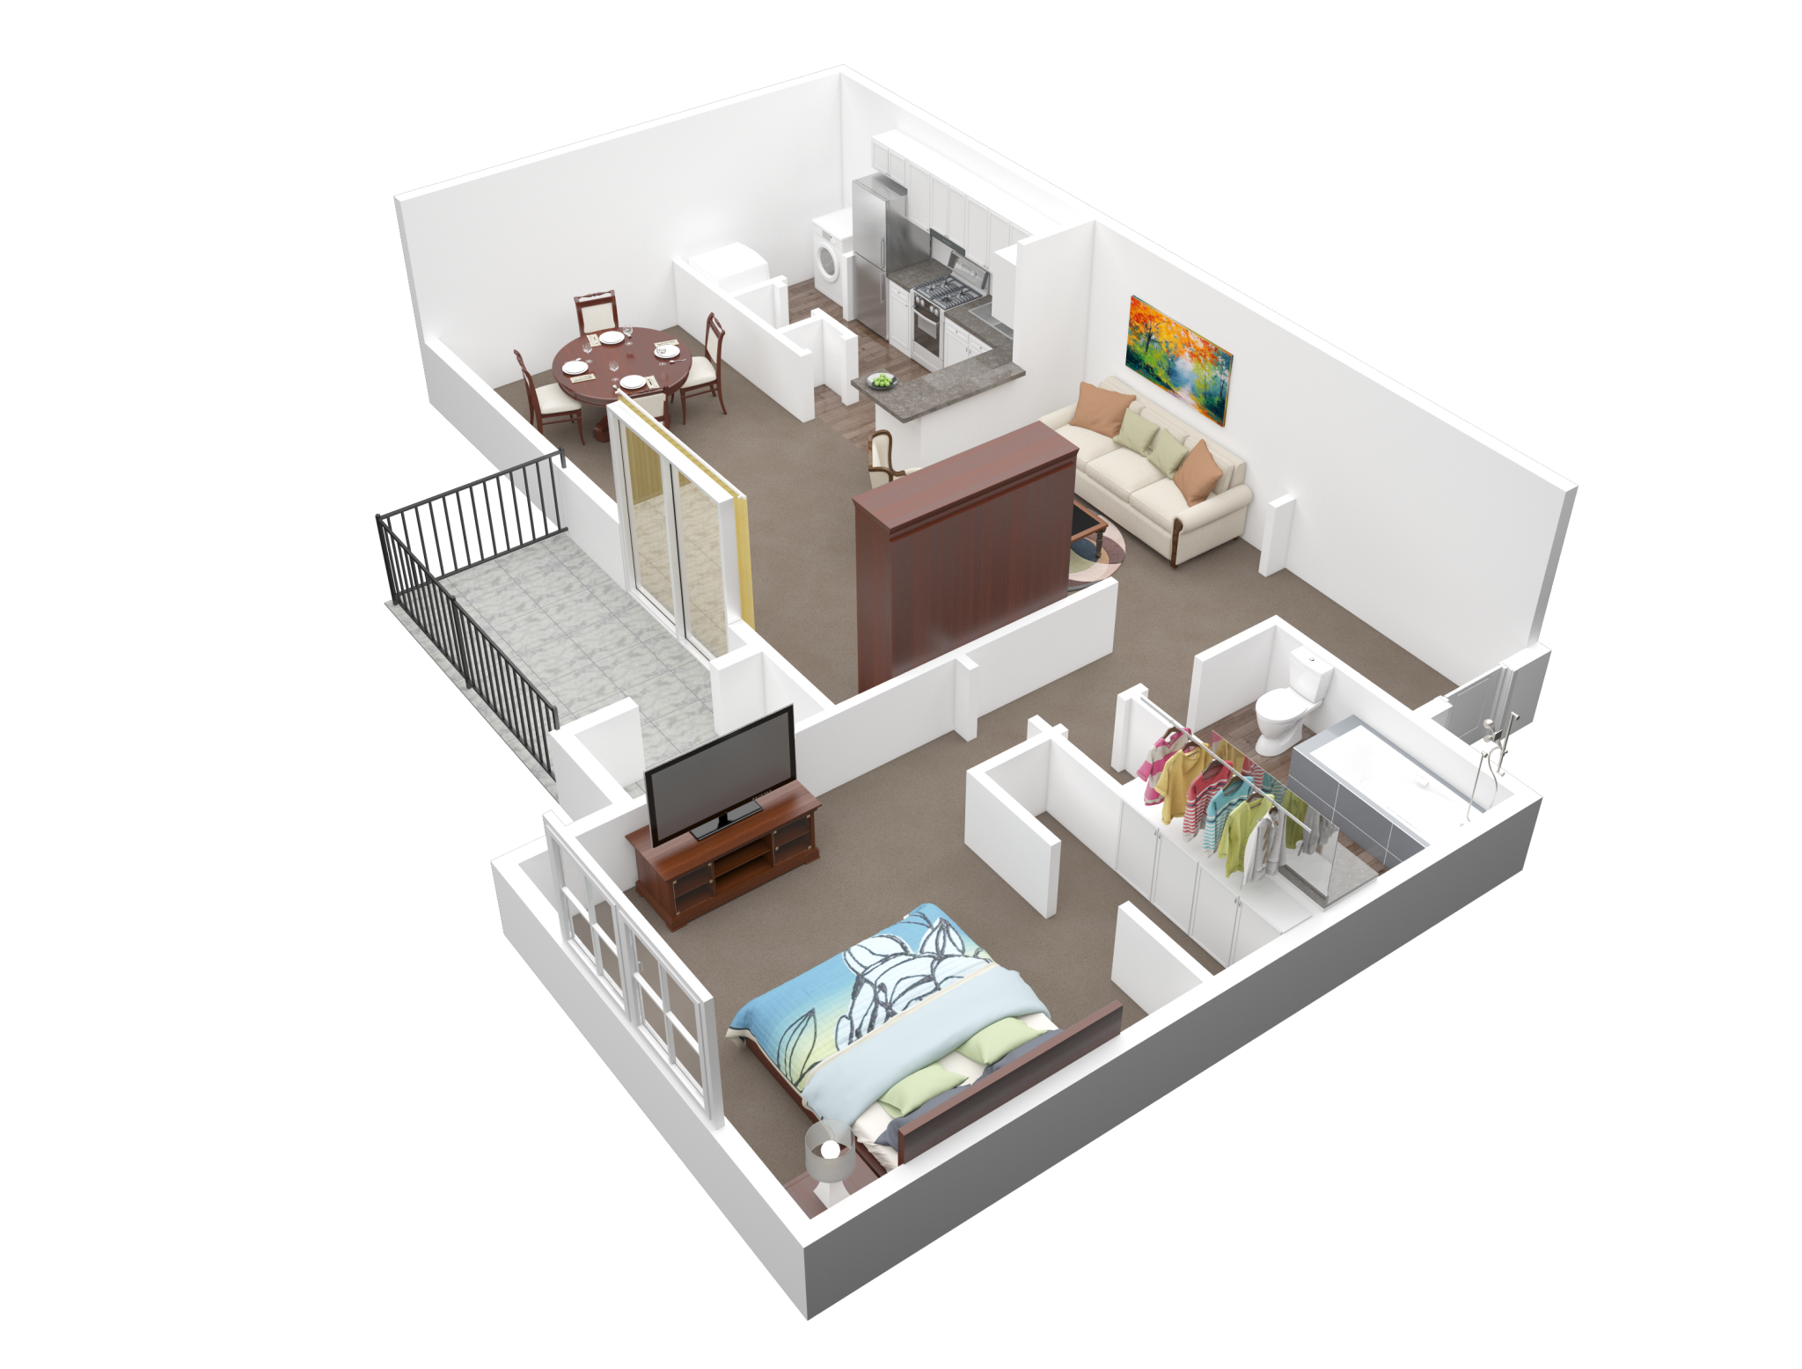

Apartment rental offers in Germany
Notes:
Presentation for the final lab…
my topik was the analysis of rental prices in berlin and germany

Slide 2
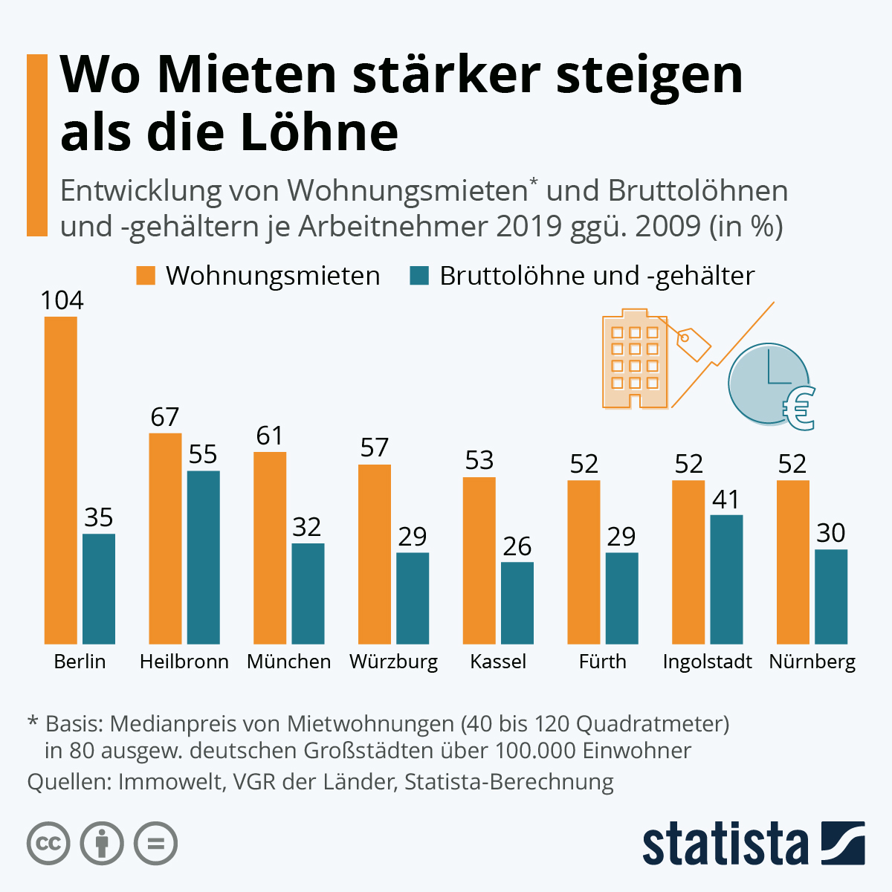
Where rents are rising faster than wages
Notes:
Finding a avordebel apartment is very hard here in Germany like you can see in the gravic
The graphic includes the eight German cities in which rents rose the most between 2009 and 2019.
The development of gross wages and salaries is included for comparison.
You can see that the rent prices increase most in berlin by 104 % in 10 years
So I want to have an overview of what is going on…

Slide 3

What I have done…
01 Overview.ipynb
02 Data cleaning.ipynb
03 Data Analysis.ipynb
04 Berlin.ipynb
05 Search App.ipynb
06 Scaping.ipynb
07 Models
08 Models_cat.ipynb
09 Clusters.ipynb
10 more Models .ipynb
11 Text Analysis.ipynb
Notes:
I created 11 jupyter notebooks

Slide 4
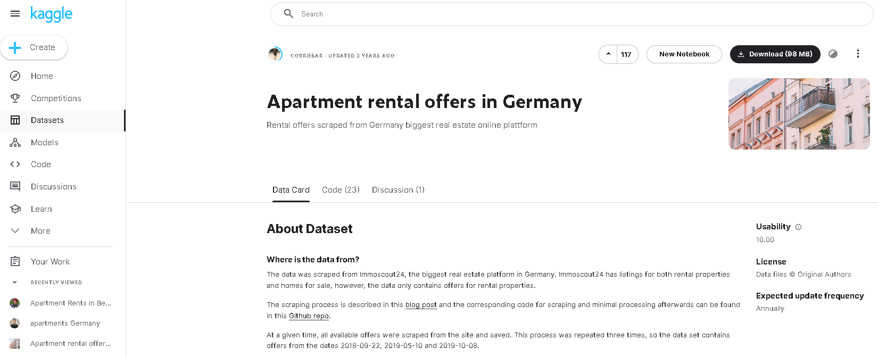
Data Source

Slide 5
Dataset
regio1
serviceCharge
heatingType
telekomTvOffer
telekomHybridUploadSpeed
newlyConst
balcony
picturecount
pricetrend
telekomUploadSpeed
totalRent
yearConstructed
scoutId
noParkSpaces
firingTypes
hasKitchen
geo_bln
cellar
yearConstructedRange
baseRent
houseNumber
livingSpace
geo_krs
condition
interiorQual
petsAllowed
street
streetPlain
lift
baseRentRange
typeOfFlat
geo_plz
noRooms
thermalChar
floor
numberOfFloors
noRoomsRange
garden
livingSpaceRange
regio2
regio3
description
facilities
heatingCosts
energyEfficiencyClass
lastRefurbish
electricityBasePrice
electricityKwhPrice
date
Euro/m2
price_class

Slide 6
Dataset
regio1
serviceCharge
heatingType
telekomTvOffer
telekomHybridUploadSpeed
newlyConst
balcony
picturecount
pricetrend
telekomUploadSpeed
totalRent
yearConstructed
scoutId
noParkSpaces
firingTypes
hasKitchen
geo_bln
cellar
yearConstructedRange
baseRent
houseNumber
livingSpace
geo_krs
condition
interiorQual
petsAllowed
street
streetPlain
lift
baseRentRange
typeOfFlat
geo_plz
noRooms
thermalChar
floor
numberOfFloors
noRoomsRange
garden
livingSpaceRange
regio2
regio3
description
facilities
heatingCosts
energyEfficiencyClass
lastRefurbish
electricityBasePrice
electricityKwhPrice
date
Euro/m2
price_class
49 columns
19x OBJECT
18x FLOAT64
6x INT64
6x BOOLEAN
268.850 rows
267.810 rows after cleaning
2.539.905 NaN-values
2 columns added

Slide 7
Dataset
regio1
serviceCharge
heatingType
telekomTvOffer
telekomHybridUploadSpeed
newlyConst
balcony
picturecount
pricetrend
telekomUploadSpeed
totalRent
yearConstructed
scoutId
noParkSpaces
firingTypes
hasKitchen
geo_bln
cellar
yearConstructedRange
baseRent
houseNumber
livingSpace
geo_krs
condition
interiorQual
petsAllowed
street
streetPlain
lift
baseRentRange
typeOfFlat
geo_plz
noRooms
thermalChar
floor
numberOfFloors
noRoomsRange
garden
livingSpaceRange
regio2
regio3
description
facilities
heatingCosts
energyEfficiencyClass
lastRefurbish
electricityBasePrice
electricityKwhPrice
date
Euro/m2
price_class
49 columns
19x OBJECT
18x FLOAT64
6x INT64
6x BOOLEAN
268.850 rows
267.810 rows after cleaning
2.539.905 NaN-values
2 columns added
Notes:
to calculate the price per square metre, i combined these two columns and then created price classes
Lets have a deeper look at the dataet…

Slide 8
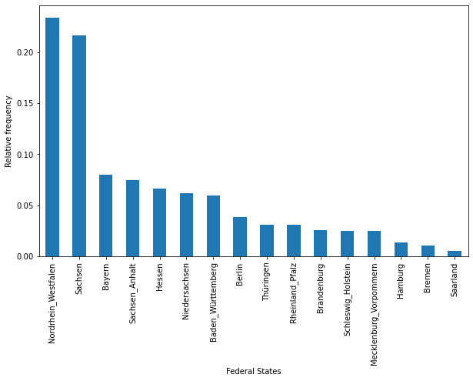
Data immoscout24.de
Notes:
over 40% of the data came from north rhine-westphalia and saxony. the remaining 60% are data from the other federal states

Slide 9
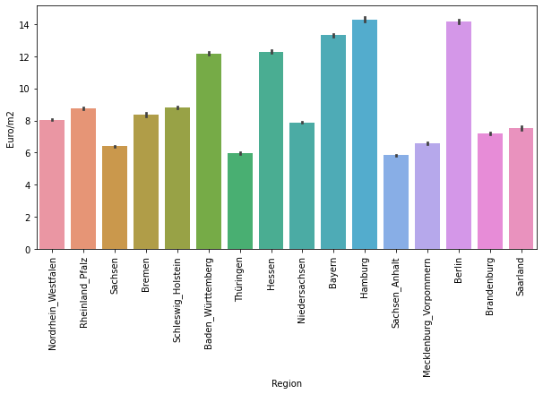


Data immoscout24.de
Notes:
the price per square meter is highest in hamburg, followed by berlin and bavaria

Slide 10
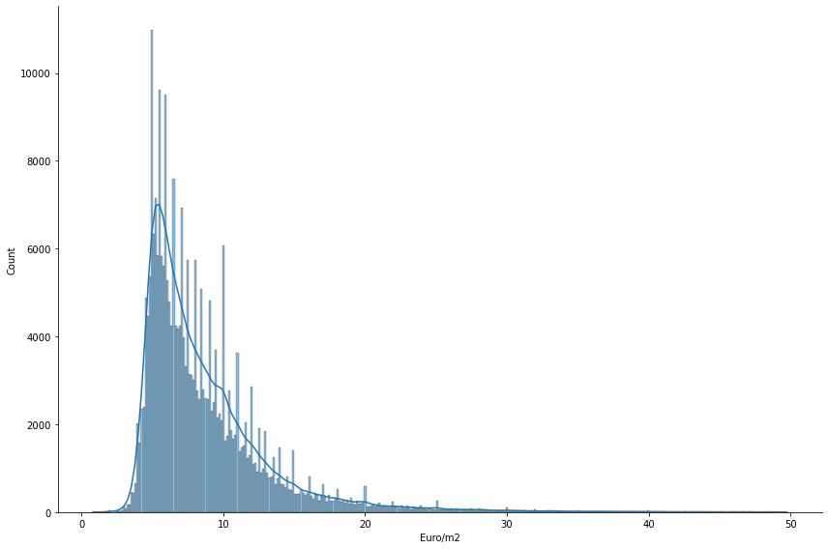
Data immoscout24.de
Notes:
Avg base rent in germany is 10.76 Euro/m²

Slide 11
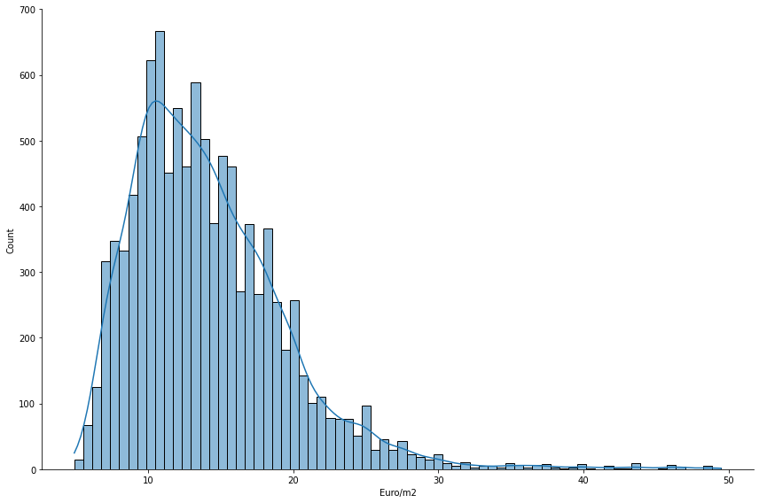
Data immoscout24.de
40% higher
in Berlin

Slide 12
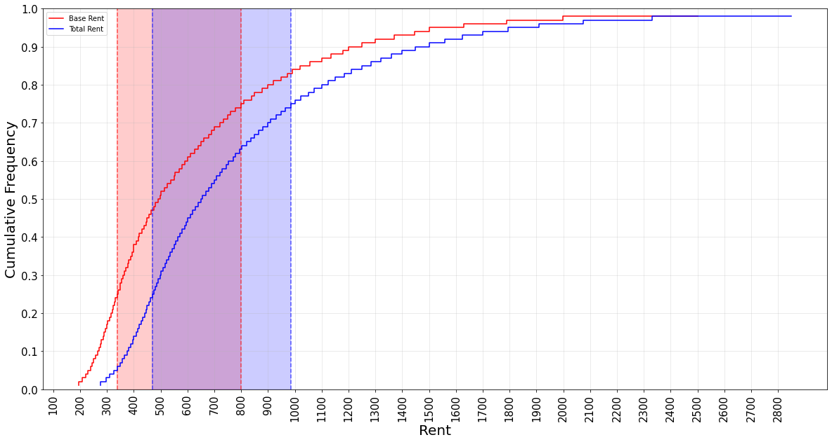
Data immoscout24.de
Notes:
50% of the base rents spans between 340 and 800 euro

Slide 13
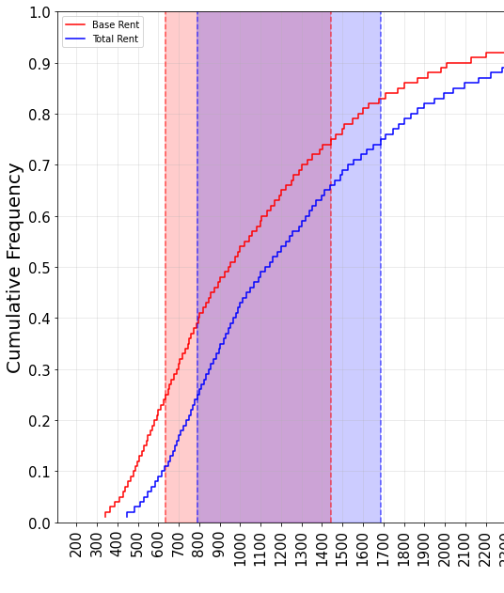
Data immoscout24.de
40-50% higher
in Berlin

Slide 14
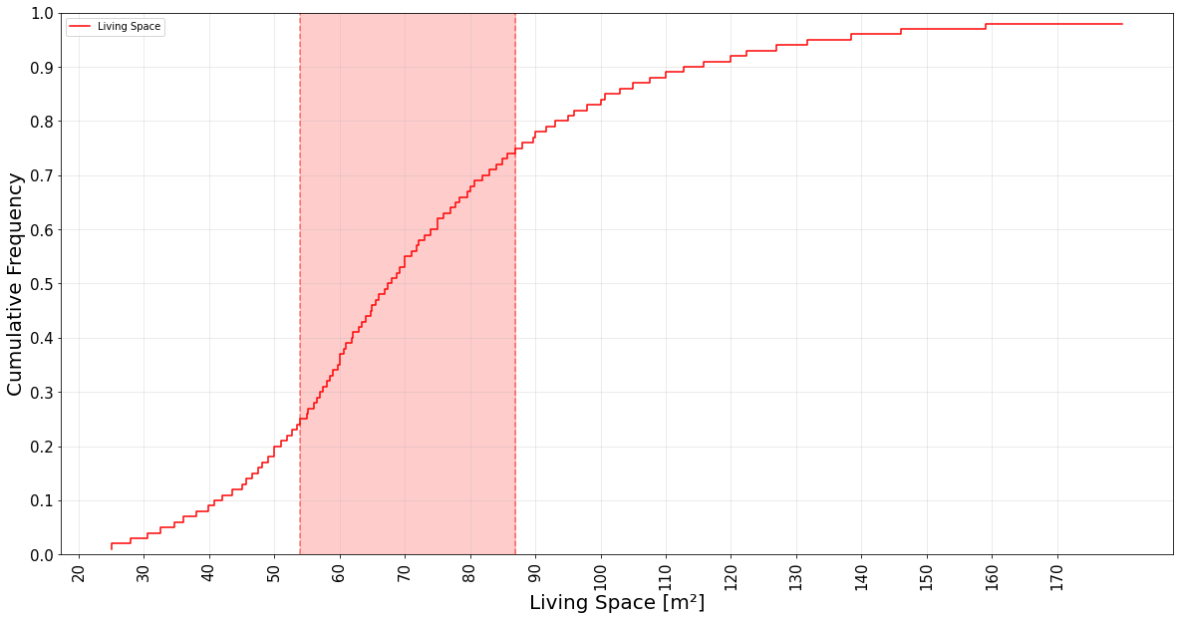
Data immoscout24.de
Notes:
50% of the living area spans between 54 and 87m²

Slide 15
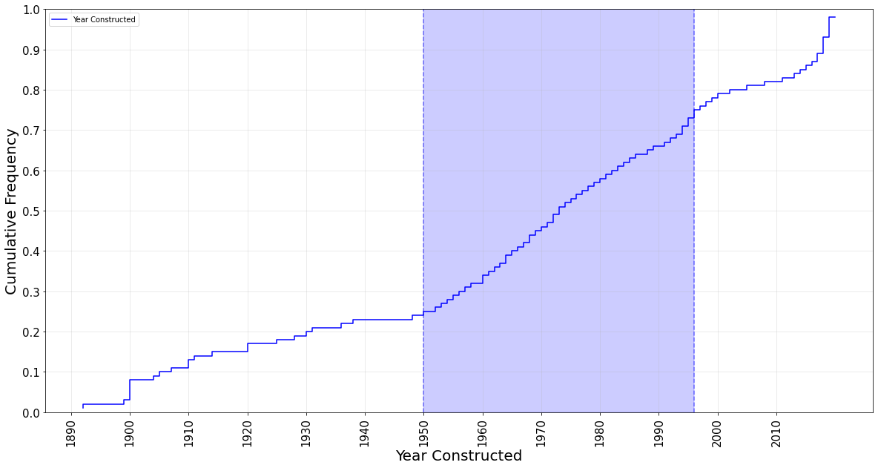
Data immoscout24.de
Notes:
50% of the apartments in the dataset were built between 1950 and 1996

Slide 16
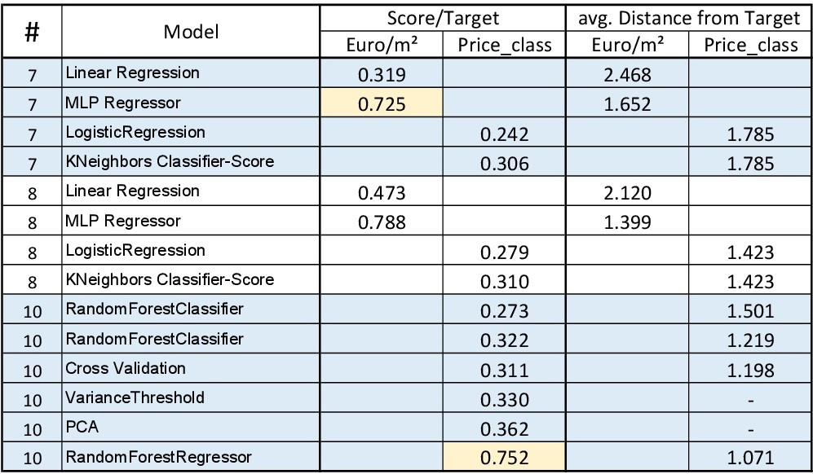
Models
Notes:
MLP Regressor (neural network) performs best with an acuracy of 79%
The Random Forest Regressor performs best on predicting the price_class
I calculated the avg. Distance from the target to the predicted value

Slide 17
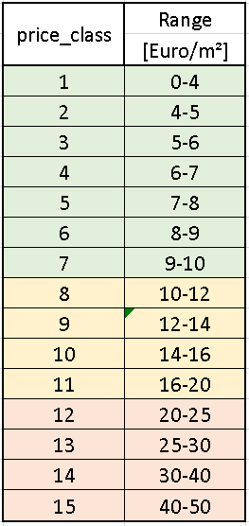
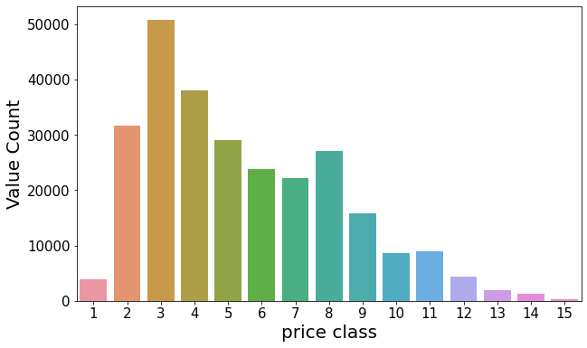
Models

Slide 18
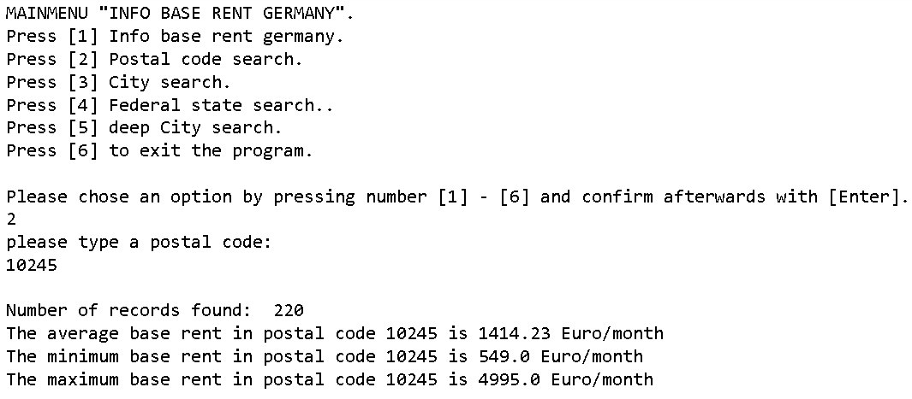
Search App

Slide 19


Slide 20
Additional content…

Slide 21
Conclusion
Many factors determine the base rent of an apartment. Many assumptions could be confirmed.
The location of the property has the greatest influence.
In addition, the following circumstances also have a influence on the base rent:
- service Charge
- newlyConst
- balcony
- cellar
- picture count
- year constructed
- number of park spaces
- has Kitchen
- living space
- lift
- last refurbish
- garden
- type of flat
- heating type
- firing type
- condition
- interior quality
- pets allowed
- number of rooms
- energy efficiency class
Notes:
The housing market remains tense in Germany. Analyzing data can help people make the right decisions.

Slide 22
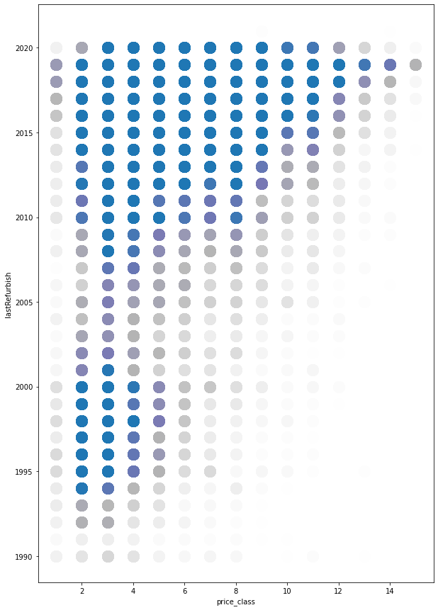
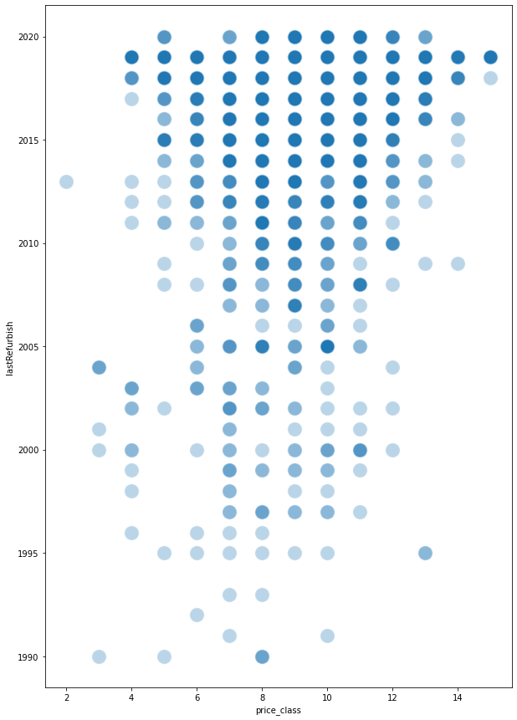
Data immoscout24.de

Slide 23
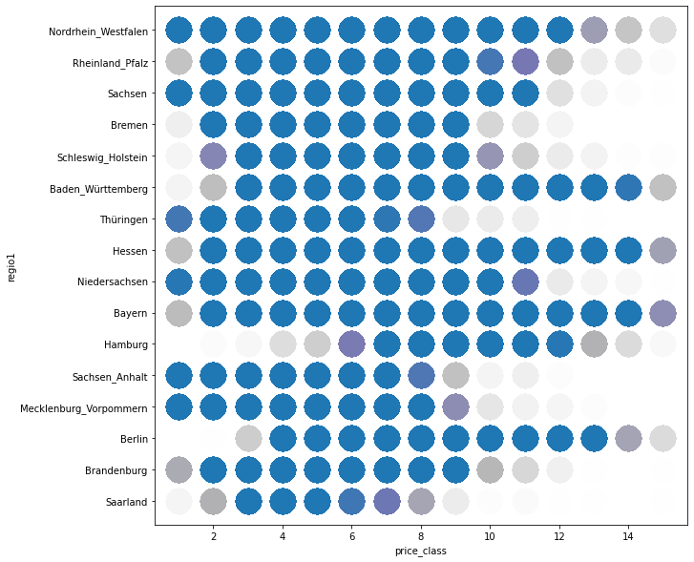
Data immoscout24.de

Slide 24
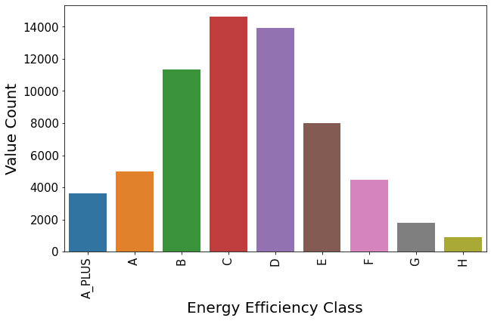
Data immoscout24.de

Slide 25
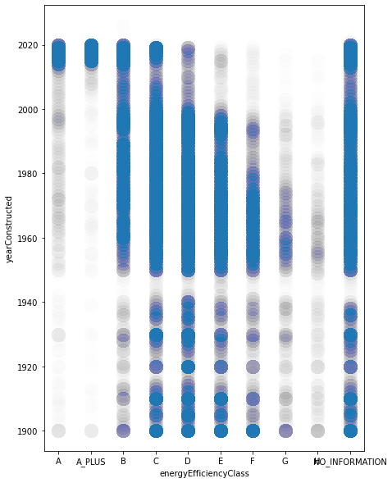
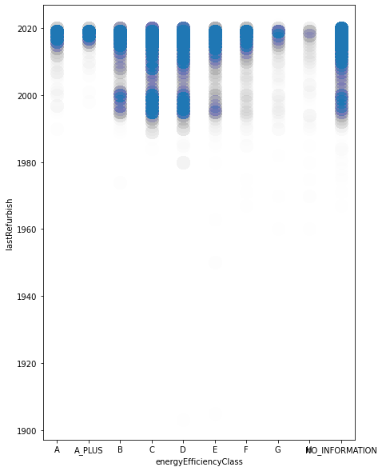
Data immoscout24.de

Slide 26
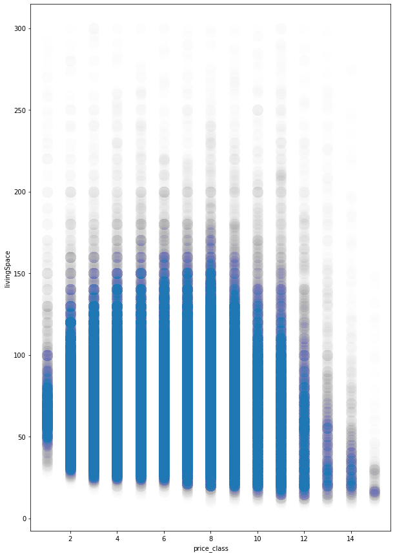
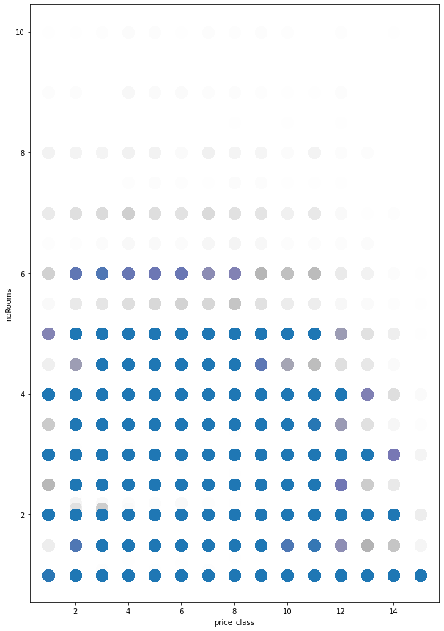
Data immoscout24.de

Slide 27
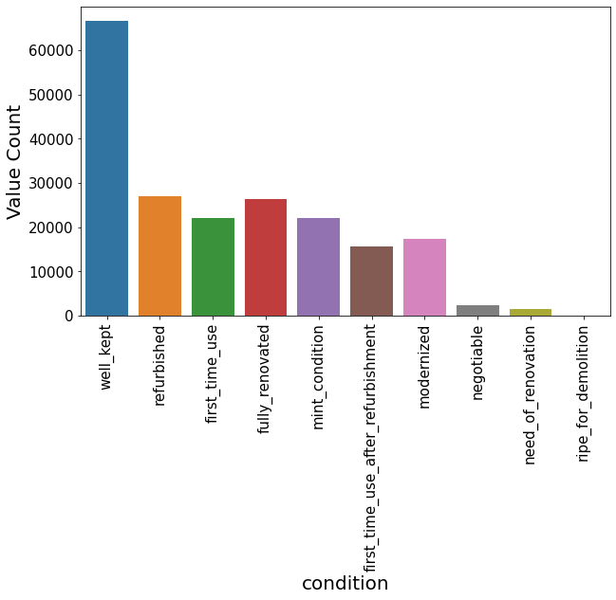
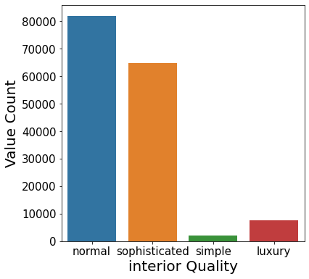
Data immoscout24.de

Slide 28
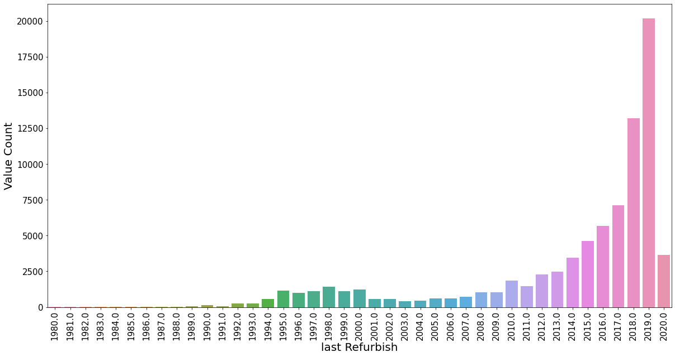
Data immoscout24.de

Slide 29
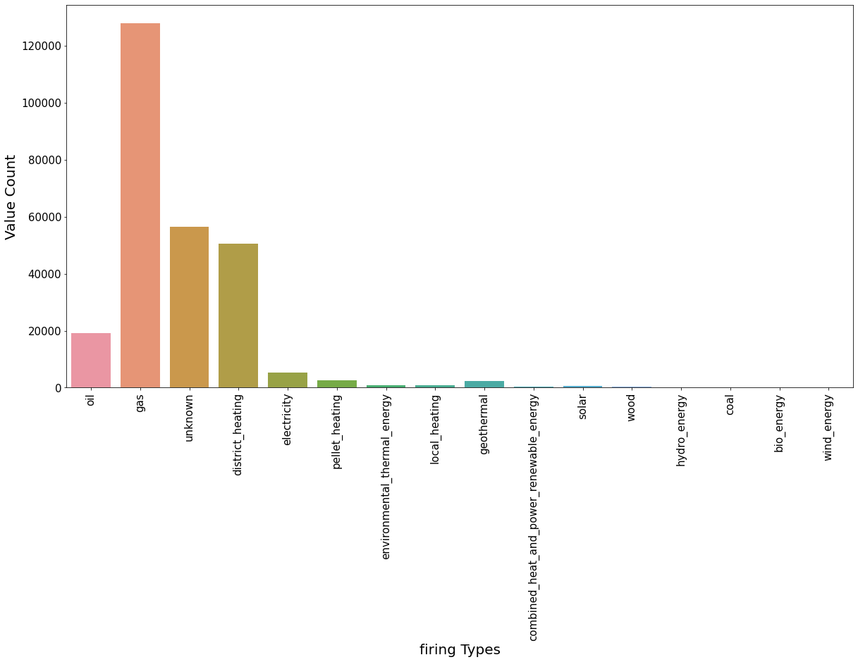
Data immoscout24.de

Slide 30
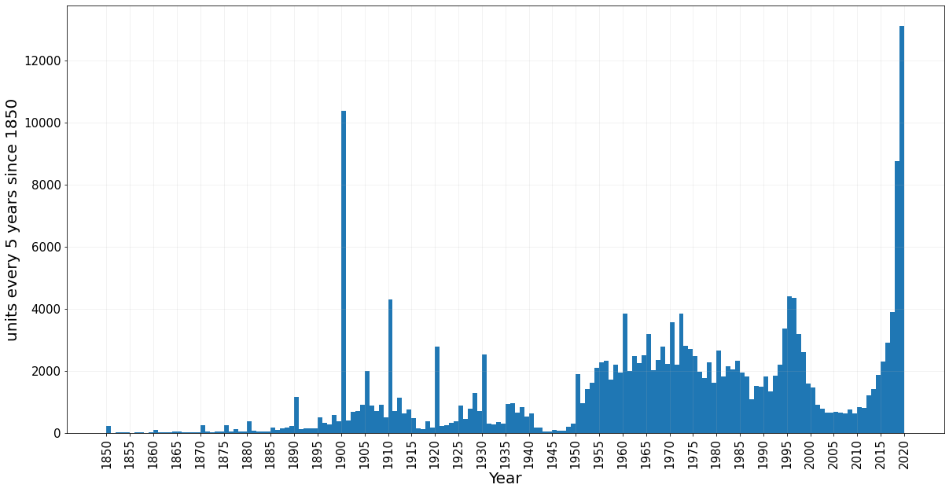
Data immoscout24.de

Slide 31
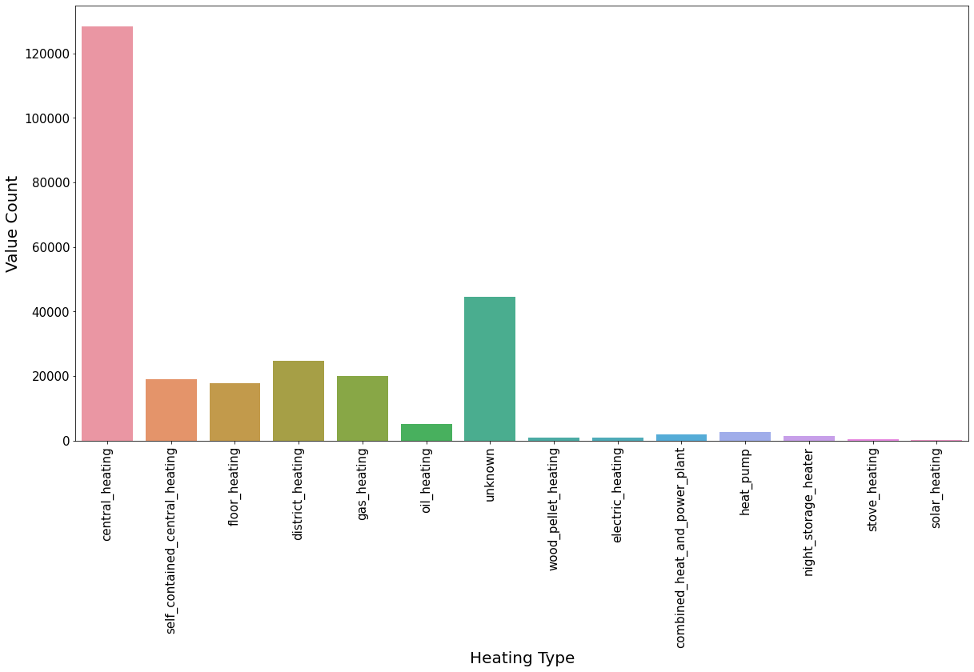
Data immoscout24.de

Slide 32
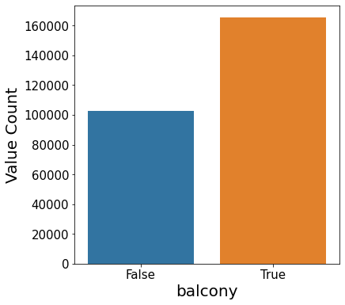
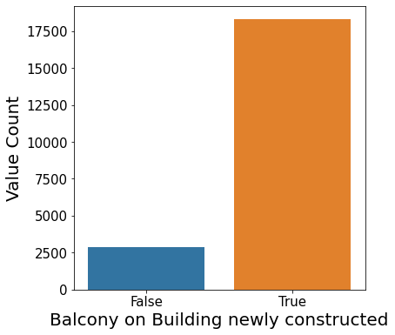
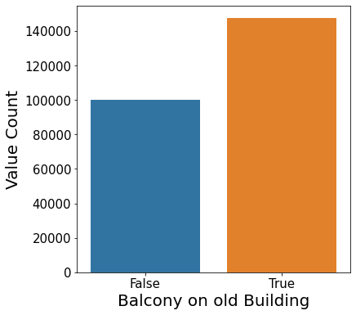
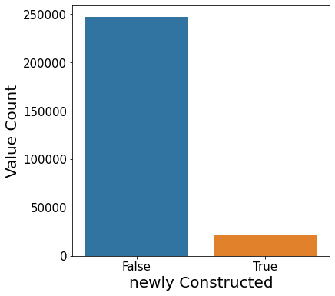
Data immoscout24.de

Slide 33
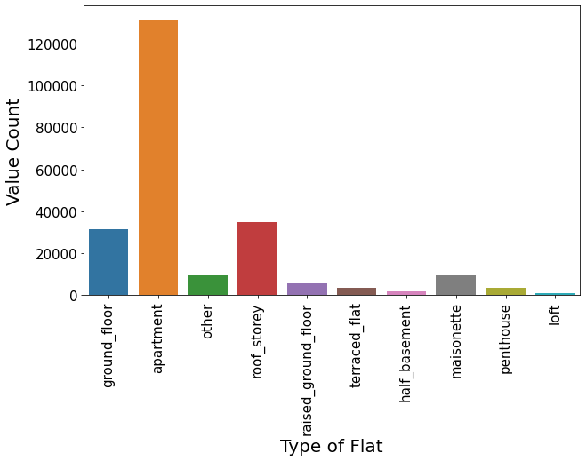
Data immoscout24.de

Slide 34
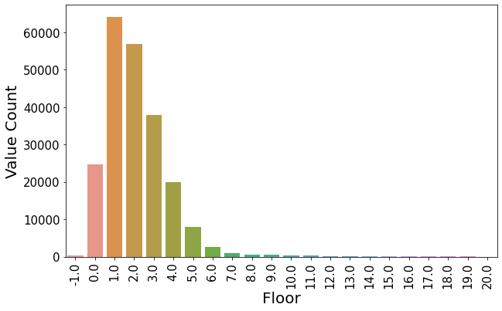
Data immoscout24.de

Slide 35
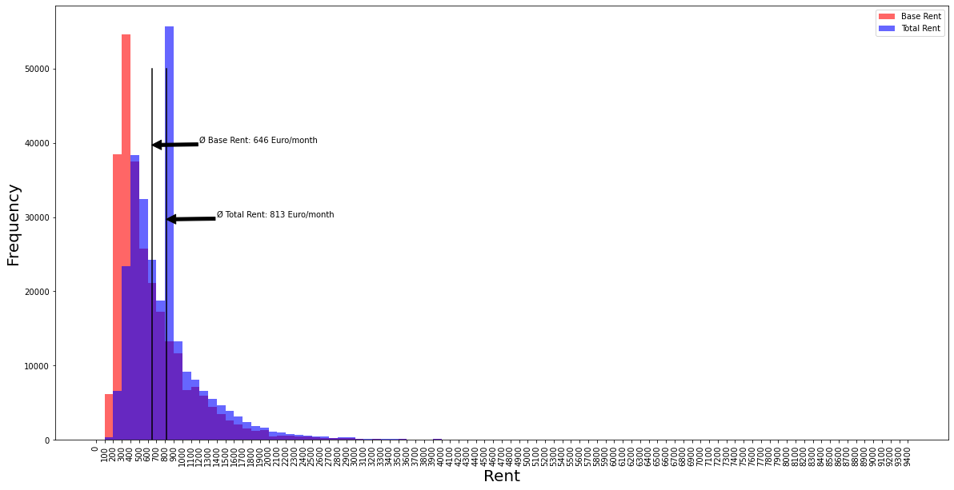
Data immoscout24.de

Slide 36
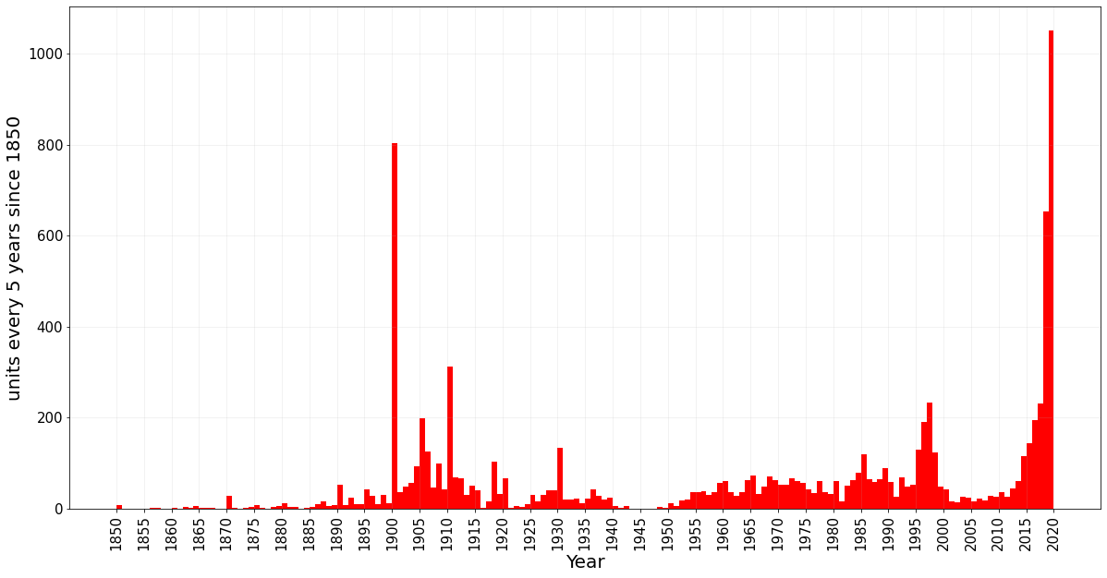
Data immoscout24.de

Slide 37
Data immoscout24.de

Slide 38
Data immoscout24.de
Notes:
18% of the data fall into priceclass 3

